Slide 1

Respect my Authority!
A Power BI Admin’s Roadmap
for adoption success
Notes:
One click to add red stripes

Slide 2
Respect my Authority!
A Power BI Admin’s Roadmap
for adoption success
Notes:
One click to remove picture and show scales spinning

Slide 3
Lets work together
A Power BI Admin’s Roadmap
for adoption success
Notes:
Balancing governance and collaboration
Working together with a few counterparts within the org, super users and everyone else who is involved in a centre of excellence (COE)
So far, a lot of buzz-words – like best practices, governance, COE and super users. If you play bullshit bingo, you will probably call bingo now!
As administrators, it's important we empathize with users rather than judge.
Our policies may seem restrictive at times, but they aim to equip the business, not hinder it.
By reaching out first to understand needs, we can tailor governance to balance control with empowerment.
With transparency and open communication, we can build trust and collaborate to securely unlock analytics potential.

Slide 4

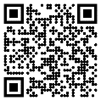

SLIDES
Notes:
Power BI administration can feel overwhelming at first.
CLICK FOR IMAGE
But don't worry! Just take it step-by-step.
Focus on learning one thing at a time.
Use the great resources available.
Ask the community for help when you need it.
Be patient with yourself as you build new skills.
Even experienced admins started as beginners.
CLICK FOR QR
Housekeeping - Links are on the images and slides will be on github

Slide 5
Key admin activities in the first four weeks:
Manage user access and security
Configure tenant settings
Manage workspaces and workspace roles
Monitor usage and capacity
Manage gateways to keep data fresh
Establish governance standards and policies
Promote collaboration through apps
Report on adoption and usage
The key is laying the foundation for governed self-service analytics by first focusing on guardrails and controls before enabling end user capabilities.
This builds trust and prevents analytics sprawl.
Notes:
Mention 4 weeks

Slide 6
Week

Slide 7
Get access
Set up security
Configure tenant settings
Assign licenses
Login to http://admin.microsoft.com with an Office 365 administrator account.
Find the user in the list of active users and select it from the list.
Then click on Manage Roles.
Under Admin centre access, expand “Show all by category”, and then from the list, select “Fabric Administrator.”
Notes:
Make friends with your AD administrator – you are about to ask THEM for a lot (and maybe it’s you)
If your business manages roles through PIM (and even if you don’t) your admin may prefer to create an AD group for Power BI Admins and just assign the “Fabric Admin” role there

Slide 8
Get access
Set up security
Configure tenant settings
Assign licenses
Start with 4 broad groups for your Power BI users:
Admin
Contributor
Tester
Viewer
Try to use the principle of least privilege.
Notes:
The key is assigning minimal required permissions to give users self-service access while maintaining control.
Naming conventions and Domains
One of the most common uses for domains is to group data by business department, making it possible for departments to manage their data according to their specific regulations, restrictions, and needs.
Mention App needs to be created by ADMIN = RUBBISH!
https://community.fabric.microsoft.com/t5/Community-Blog/Domain-Preview-Power-BI-Services/ba-p/3308166

Slide 9
Get access
Set up security
Configure tenant settings
Assign licenses
Start with 4 broad groups for your Power BI users:
Admin
Contributor
Tester
Viewer
Try to use the principle of least privilege.
Notes:
The key is assigning minimal required permissions to give users self-service access while maintaining control.
Naming conventions and Domains
One of the most common uses for domains is to group data by business department, making it possible for departments to manage their data according to their specific regulations, restrictions, and needs.
https://community.fabric.microsoft.com/t5/Community-Blog/Domain-Preview-Power-BI-Services/ba-p/3308166

Slide 10
Get access
Set up security
Configure tenant settings
Assign licenses
Start with 4 broad groups for your Power BI users:
PowerBI-{Domain}-Admin
PowerBI-{Domain}-Contributor
PowerBI-{Domain}-Tester
PowerBI-{Domain}-Viewer
Try to use the principle of least privilege.
Notes:
AD Groups should follow security best practices and be maintained as new employees join/leave the organization;
I recommend hooking the viewer groups into existing distribution lists or using dynamic membership
https://datameerkat.com/domains

Slide 11
Get access
Set up security
Configure tenant settings
Assign licenses
Now you can create some more specialised groups to control the backstage activities:
PowerBI-GatewayAdmin
Install and configure on-premises data gateways to enable access to
on-prem data sources.
PowerBI-WorkspaceCreator
Allowing any user to create workspaces can lead to proliferation
of uncontrolled workspaces.
PowerBI-DemoViewer
Dynamic membership (user.objectId -ne null) and (user.userType -eq "member")
Notes:
Install and configure on-premises data gateways to enable access to on-prem data sources.
Keep them UP TO DATE
Determine optimal gateway placement on allowed networks with required drivers and dependencies installed.
Manage gateway connections, encryption keys, and credentials securely.

Slide 12
Get access
Set up security
Configure tenant settings
Assign licenses
Now you can create some more specialised groups to control the backstage activities:
PowerBI-GatewayAdmin
Install and configure on-premises data gateways to enable access to
on-prem data sources.
PowerBI-WorkspaceCreator
Allowing any user to create workspaces can lead to proliferation
of uncontrolled workspaces.
PowerBI-DemoViewer
Dynamic membership (user.objectId -ne null) and (user.userType -eq "member")
Notes:
Implement a workspace request process for other users to submit business justification.
Expand workspace creation access more broadly over time in a governed manner.
Educate users that workspaces are for collaboration, not personal storage.

Slide 13
Get access
Set up security
Configure tenant settings
Assign licenses
Now you can create some more specialised groups to control the backstage activities:
PowerBI-GatewayAdmin
Install and configure on-premises data gateways to enable access to
on-prem data sources.
PowerBI-WorkspaceCreator
Allowing any user to create workspaces can lead to proliferation
of uncontrolled workspaces.
PowerBI-DemoViewer
Dynamic membership (user.objectId -ne null) and (user.userType -eq "member")
Notes:
All users – Member only (no guests)

Slide 14

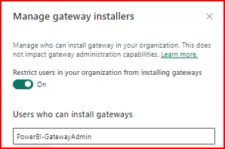
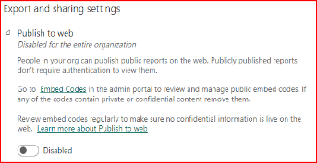
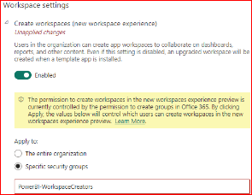
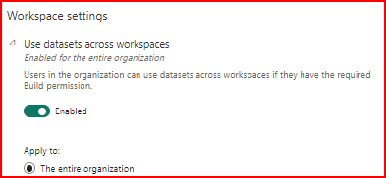
Get access
Set up security
Configure tenant settings
Assign licenses
Gateway Admin
Workspace Creator
Publish to web
Dataset sharing
Notes:
If you miss configuring the settings properly, it may result in leaking the data, authorizing people who should not be authorized to see reports and many other catastrophic scenarios
Remember those groups we just created; this is where we will use them.
XXXX
Sadly, this doesn’t work for Gateway Admin yet
You may want to restrict pro trials at this time too
https://radacad.com/power-bi-administrator-tenant-settings-configuration-you-dont-dare-to-miss

Slide 15
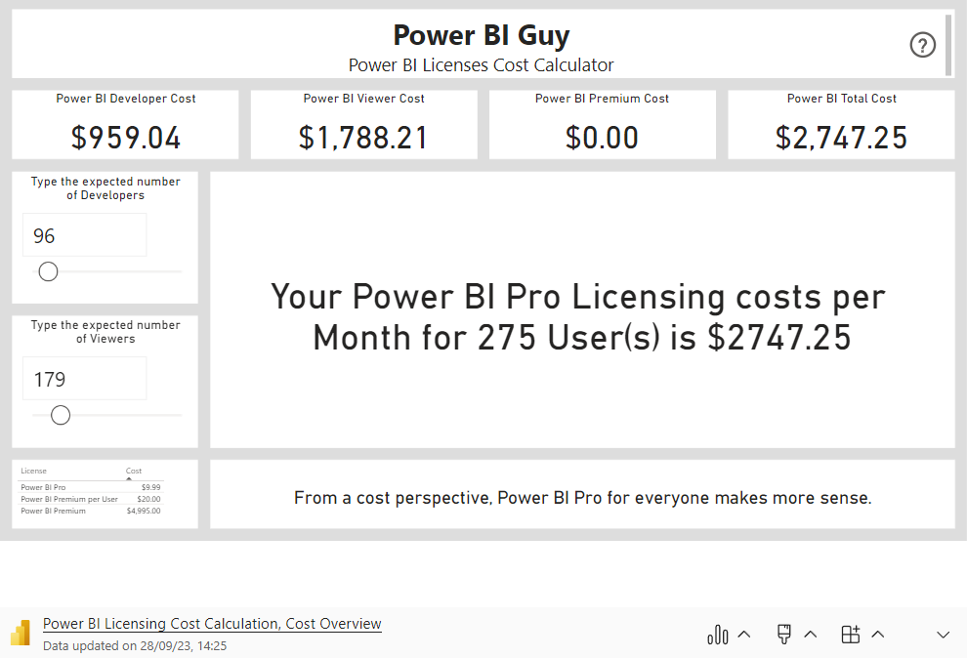
Get access
Set up security
Configure tenant settings
Assign licenses
Notes:
Purchase and assign Power BI licenses to users
Decide on Pro vs Premium vs Fabric
E5 gets Pro for free – advise to turn that off to encourage community practices
https://app.powerbi.com/view?r=eyJrIjoiOTc4Y2Q2YzAtOTAwZi00OWJiLWE4MDctN2MyOGU2M2Q5NWNjIiwidCI6IjIxMmFhOGVkLTcxYzYtNGY3ZS1hM2Q1LWNjOWQ2NmZiZGY5YSJ9&pageName=ReportSection

Slide 16

Week

Slide 17

Create workspaces
Build admin reports
Install Gateways
Build a vending machine so people can see what is available
Notes:
Data Hub – make it available in Teams

Slide 18
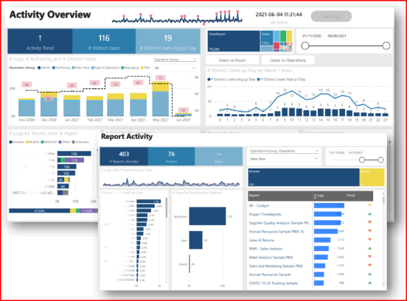
Create workspaces
Build admin reports
Install Gateways
Build a workspace for usage monitoring

Slide 19
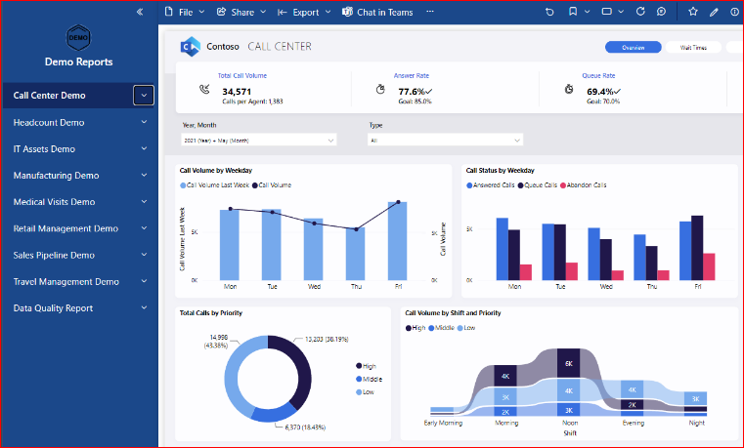
Create workspaces
Build admin reports
Install Gateways
Build a workspace for demo reports

Slide 20
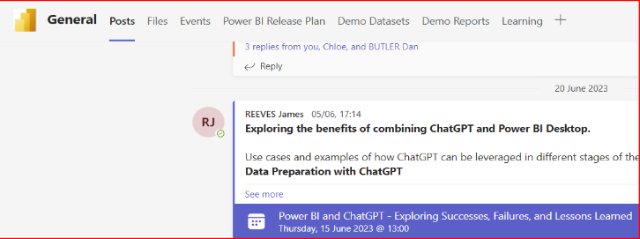
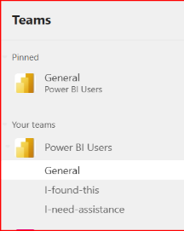
Create workspaces
Build admin reports
Install Gateways
Put it where they can see it
Notes:
Data Hub – make it available in Teams

Slide 21
Create workspaces
Build admin reports
Install Gateways
The door is open – come and see what we can do together!

Slide 22
Create admin workspace
Build admin reports
Install Gateways
Can you answer these questions?
Who are most active users
Which Reports/Workspaces/Datasets/Apps are used every day
How is content being shared & distributed? Any content on My Workspace
Do your users access from Browser/Mobile/Excel? Which browser
Top used Data Source’s
How many distinct users (Per Month, Per day, Per hour)
Datasets/Reports not used recently
How many users with license don’t use Power BI in more than 3 months
Are developers following the naming conventions
Notes:
https://github.com/RuiRomano/sessionslides/blob/main/PBIMonitoring101.pdf

Slide 23
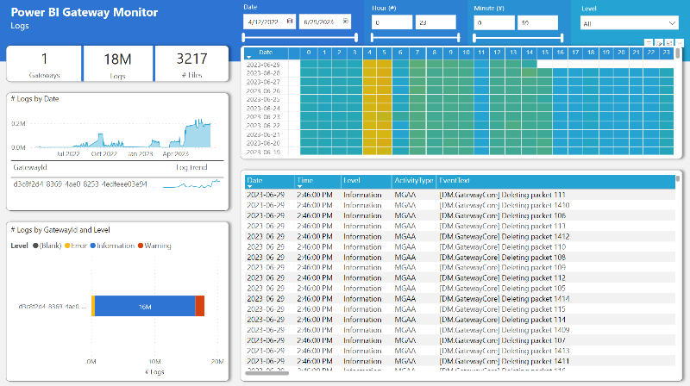
Create admin workspace
Build admin reports
Install Gateways
Install and configure on-premises data gateways
Notes:
https://github.com/RuiRomano/pbigtwmonitor

Slide 24

Week

Slide 25
Create team workspaces
Publish data sources
Train Users
Collaboration spaces for business units with designated admins

Slide 26
Create team workspaces
Publish data sources
Train Users
Enable users to discover certified data sources

Slide 27
Create team workspaces
Publish data sources
Train Users
Conduct training webinars on new features and self-service

Slide 28

Week

Slide 29
Monitor usage
Address issues
Promote content
Report to stakeholders
Review adoption, consumption, most used reports
Notes:
Create your baselines – something to refer back to in future

Slide 30

Monitor usage
Address issues
Promote content
Report to stakeholders
Troubleshoot based on user feedback

Slide 31
Monitor usage
Address issues
Promote content
Report to stakeholders
Feature examples and best practices from users

Slide 32
Monitor usage
Address issues
Promote content
Report to stakeholders
Share Power BI rollout insights and next steps

Slide 33

JAMES REEVES
Azure Consultant
Let’s connect!

